Slide 1
Spring MVC

Slide 2
Introduction to Spring Web MVC framework
The Spring Web model-view-controller (MVC) framework is designed around a DispatcherServlet that dispatches requests to handlers, with configurable handler mappings, view resolution, locale and theme resolution as well as support for uploading files.

Slide 3
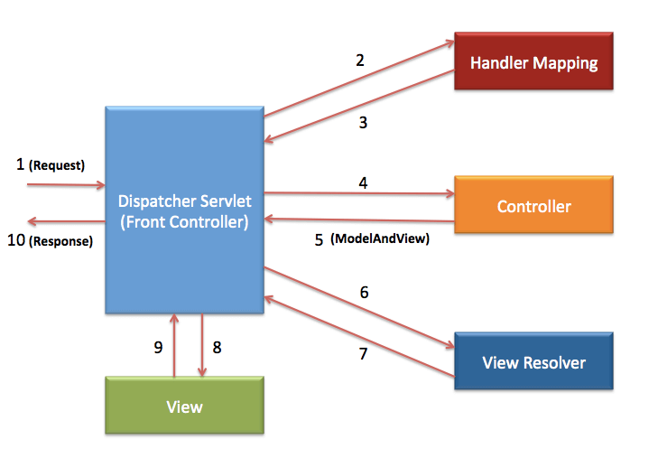

Slide 4
Spring MVC Dependencies
<dependency>
<groupId>org.springframework</groupId>
<artifactId>spring-context</artifactId>
<version>4.0.3.RELEASE</version>
</dependency>
<dependency>
<groupId>org.springframework</groupId>
<artifactId>spring-webmvc</artifactId>
<version>4.0.3.RELEASE</version>
</dependency>

Slide 5
DispatcherServlet
Configuration file
<servlet-name>-servlet.xml
In this case :
spring-servlet.xml (location : WEB-INF)
<web-app xmlns="http://java.sun.com/xml/ns/javaee" xmlns:xsi="http://www.w3.org/2001/XMLSchema-instance"
xsi:schemaLocation="http://java.sun.com/xml/ns/javaee
http://java.sun.com/xml/ns/javaee/web-app_2_5.xsd"
version="2.5">
<display-name>SpringSampleProject</display-name>
<servlet>
<servlet-name>spring</servlet-name>
<servlet-class>org.springframework.web.servlet.DispatcherServlet</servlet-class>
<load-on-startup>1</load-on-startup>
</servlet>
<servlet-mapping>
<servlet-name>spring</servlet-name>
<url-pattern>/</url-pattern>
</servlet-mapping>
</web-app>

Slide 6
beans xmlns="http://www.springframework.org/schema/beans"
xmlns:context="http://www.springframework.org/schema/context"
xmlns:mvc="http://www.springframework.org/schema/mvc"
xmlns:xsi="http://www.w3.org/2001/XMLSchema-instance"
xsi:schemaLocation="
http://www.springframework.org/schema/beans
http://www.springframework.org/schema/beans/spring-beans.xsd
http://www.springframework.org/schema/context
http://www.springframework.org/schema/context/spring-context.xsd
http://www.springframework.org/schema/mvc
http://www.springframework.org/schema/mvc/spring-mvc-3.0.xsd">
<mvc:annotation-driven/>
<context:component-scan base-package="com.controllers.*" />
Enables Annotaion for autowiring
To scan the packages

Slide 7
View Resolver Configuration
<bean
class="org.springframework.web.servlet.view.InternalResourceViewResolver">
<property name="prefix">
<value>/WEB-INF/pages/</value>
</property>
<property name="suffix">
<value>.jsp</value>
</property>
</bean>

Slide 8
Controller
<bean
class="org.springframework.web.servlet.view.InternalResourceViewResolver">
<property name="prefix">
<value>/WEB-INF/pages/</value>
</property>
<property name="suffix">
<value>.jsp</value>
</property>
</bean>
@Controller
public class HelloController {
@RequestMapping("/")
public String sayHello()
{
return “hello";
}
hello.jsp
In /WEB-INF/pages/
http://localhost:8080/BookStore/
Where BookStore is the Project Name

Slide 9
Web App using Java Configuration
// In place of web.xml
public class WebServletConfiguration implements WebApplicationInitializer{
public void onStartup(ServletContext ctx) throws ServletException {
AnnotationConfigWebApplicationContext webCtx = new AnnotationConfigWebApplicationContext();
webCtx.register(MyConfiguration.class);
webCtx.setServletContext(ctx);
ServletRegistration.Dynamic servlet = ctx.addServlet("dispatcher", new DispatcherServlet(webCtx));
servlet.setLoadOnStartup(1);
servlet.addMapping("/");
}
}

Slide 10
// In place of spring-servlet.xml
@Configuration
@EnableWebMvc
@ComponentScan("com.training.bookstore")
public class MyConfiguration extends WebMvcConfigurerAdapter{
@Override public void configureDefaultServletHandling(DefaultServletHandlerConfigurer configurer) {
configurer.enable(); }
}

Slide 11
Steps for Simple MVC in Spring
Add dependencies in Maven/Dynamic web project
Configure DispatcherServlet in web.xml
Create configuration xml file
add the required elements
Create controller
Add Request mapping
Run the server
Type the url in browser

Slide 12
//reading parameters from Http Get request
@RequestMapping("/getbook")
public String getbook(@RequestParam("isbn")
String isbn,Model model)
{
Book book = bookService.getBook(isbn);
model.addAttribute("book", book);
System.out.println(book);
return "book";
}
//Creating request attribute
@RequestMapping("/home")
public String start(Model model)
{
model.addAttribute("book",new Book(“21”,”C”));
return "bookform";
}
//bookform.jsp
<%@ page isELIgnored="false" %>
<%@ taglib uri="http://java.sun.com/jsp/jstl/core" prefix="c"%>
${book.isbn}<br>
${book.title}
Prints 21 C

Slide 13
For Database Configuration
<bean id="dataSource" class="org.apache.commons.dbcp.BasicDataSource"
destroy-method="close">
<property name="driverClassName" value="com.mysql.jdbc.Driver" />
<property name="url"
value="jdbc:mysql://localhost:3306/training" />
<property name="username" value="root" />
<property name="password" value="root" />
</bean>
<dependency>
<groupId>commons-dbcp</groupId>
<artifactId>commons-dbcp</artifactId>
<version>1.4</version>
</dependency>

Slide 14
Mapping Hibernate properties
<bean id="hibernate4AnnotatedSessionFactory"
class="org.springframework.orm.hibernate4.LocalSessionFactoryBean">
<property name="dataSource" ref="dataSource" />
<property name="annotatedClasses">
<list>
<value>com.classes.Book</value>
</list>
</property>
<property name="hibernateProperties">
<props>
<prop key="hibernate.dialect">org.hibernate.dialect.MySQLDialect
</prop>
<prop key="hibernate.show_sql">true</prop>
<prop key="hbm2ddl.auto">create</prop>
</props>
</property>
</bean>
Creates a table

Slide 15
<bean id="dataSource"
class="org.springframework.jdbc.datasource.DriverManagerDataSource">
<property name="driverClassName" value="com.mysql.jdbc.Driver" />
<property name="url" value="jdbc:mysql://localhost:3306/jpmc1" />
<property name="username" value="root" />
<property name="password" value="root" />
</bean>
<bean id="myEmf"
class="org.springframework.orm.jpa.LocalContainerEntityManagerFactoryBean">
<property name="dataSource" ref="dataSource" />
<property name="jpaProperties">
<props>
<prop key="hibernate.hbm2ddl.auto">update</prop>
<prop key="hibernate.dialect">org.hibernate.dialect.MySQL5Dialect</prop>
<prop key="hibernate.show_sql">true</prop>
</props>
</property>
</bean>
To integrate with JPA

Slide 16
ContextLoaderListener – Root application context
ContextLoaderListener creates the root application context and will be shared with child contexts created by all DispatcherServlet contexts. You can have only one entry of this in web.xml.
web.xml
<listener>
<listener-class>
org.springframework.web.context.ContextLoaderListener
</listener-class>
</listener>
<context-param>
<param-name>contextConfigLocation</param-name>
<param-value>/WEB-INF/spring/applicationContext.xml</param-value>
</context-param>
This will be the configuration file now

Slide 17
Sample Dao Implementations
@Autowired
private SessionFactory sf;
Dao Implementation
To retrieve records
public List<Book> getAllBooks() {
Session s= sf.openSession();
return s.createQuery("from Book").list();
}
Adds Records to DB
public boolean addBook(Book book) {
Session s=sf.openSession();
s.getTransaction().begin();
s.save(book);
s.getTransaction().commit();
return true;
}
Follow the same steps for other operations

Slide 18
//Using hibernate
@Repository
public class BookDao implements BookDaoI {
@Autowired
private SessionFactory sessionFactory;
public boolean addBook(Book book) {
Session session = sessionFactory.openSession();
//Transaction tx=session.beginTransaction();
session.persist(book);
// tx.commit();
return false;
}
public interface BookDaoI {
public boolean addBook(Book book);
public Book getBook(String isbn);
public Book updateBook(Book book);
public List<Book> getAllBooks();
public Book deleteBook(Book book);
}
}
<bean id="transactionManager"
class="org.springframework.orm.hibernate4.HibernateTransactionManager">
<property name="sessionFactory" ref="sessionFactory" />
</bean>
<tx:annotation-driven transaction-manager="transactionManager" proxy-target-class="true"/>

Slide 19
//Using JPA
@Repository
public class BookDao implements BookDaoI {
@PersistenceContext
private EntityManager em;
@Transactional
@Override
public boolean addBook(Book book) {
System.out.println("In Book Dao");
//em.getTransaction().begin();
em.persist(book);
//em.getTransaction().commit();
return true;
}
<bean id="transactionManager"
class="org.springframework.orm.jpa.JpaTransactionManager">
<property name="entityManagerFactory" ref="myEmf" />
</bean>
<tx:annotation-driven transaction-manager="transactionManager" proxy-target-class="true"/>

Slide 20
Other Operations using JPA
@Override
public List<Book> getAllBooks() {
return em.createQuery("from Book b").getResultList();
}
@Override
public void deleteBook(String isbn) {
em.remove(em.find(Book.class, isbn));
}
@Override
public Book getBook(String isbn) {
// TODO Auto-generated method stub
return em.find(Book.class, isbn);
}
@Override
public Book updateBook(Book bookUp) {
// TODO Auto-generated method stub
em.remove(em.find(Book.class,bookUp.getIsbn()));
em.persist(bookUp);
return bookUp;
}

Slide 21
// Sample Spring UI form
<html>
<head>
<title>
</title>
<body>
<a href="getallbooks">Go to Book Store</a>
<br><br>
<%@ taglib uri="http://www.springframework.org/tags/form" prefix="form"%>
<form:form name="f1" method="post" action="bookdetails" modelAttribute="book">
<table >
<tr>
<td>Isbn : </td>
<td><form:input path="isbn" />
<form:errors path="isbn" cssStyle="color: #ff0000;"/>
</td>
</tr>
</table>
<input type="submit" value="add"/>
</form:form>
</body>
</html>

Slide 22
Spring UI Forms and Data Binding
//bookform.jsp
<form:form name="f1" method="get" action="addbook" modelAttribute="book" >
<table >
<tr>
<td>Isbn : </td>
<td><form:input path="isbn" />
<form:errors path="isbn" cssStyle="color: #ff0000;"/></td>
@RequestMapping("/addbook")
public String addBook(@Valid @ModelAttribute("book") Book book,
BindingResult result,Model model)
{
if(result.hasErrors()) return "bookform";
boolean status = bookService.addBook(book);
if(status)
model.addAttribute("message","Book Added..");
else
model.addAttribute("message","Error in adding Book");
return "success";
}
Isbn is an attribute in bean Book

